Slide 1

Name:- Aavash Acharya
UID:- 26BAI10182
Section:-218-A
Subject name:- (LTPS)
Subject code:-26CSH-111
Subject teacher name:-Mr Bhavesh sir

Slide 2
Table Of Content
Content | Page No
Picture | 1
Introduction | 2
Objectives | 3
Features | 4
Types Of Requriments | 5
Concept Used | 6
Grading System | 7
Algorithm | 8
Flowchart | 9
Code | 10
Sample Output | 11
Advantages | 12
Limations | 13
Conclusion | 14

Slide 3
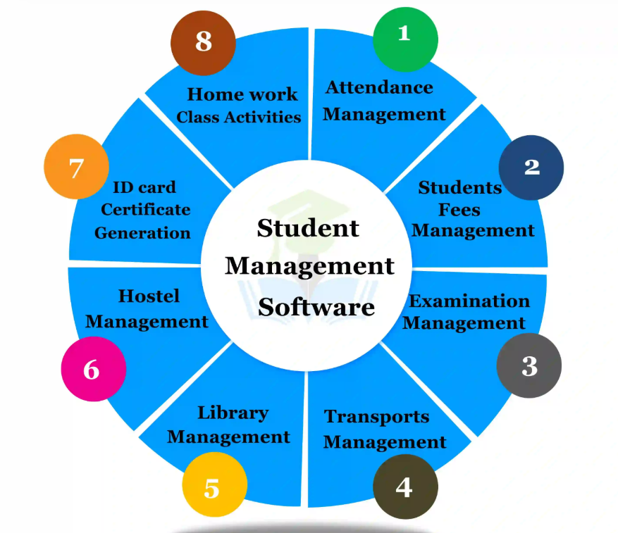
Student Management system

Slide 4
Inroduction
The Student Performance Management System is a simple project developed using the C programming language. It helps us manage student marks and academic records easily.Through this program, we can enter student details, calculate total marks, find percentages and check grades. It reduces manual calculations and makes the work easier.
1

Slide 5
Objectives
To store basic student details.
To enter marks of different subjects.
To calculate total marks.
To find the percentage and grade.
To display student performance.
2

Slide 6
Features
Enter student name and roll number.
Enter marks of five subjects.
Calculate total marks automatically.
Calculate percentage.
Display student grade.
Show complete student details.
3

Slide 7
Types Of Requriments
Software Requriments
Hardware Requriments
Programming Language: C
Compiler: Code::Blocks or GCC
Operating System: Windows
Computer or Laptop
Keyboard
Monitor
4

Slide 8
Concepts Used
Structure: Used to store student details like name, roll number and marks.
Array: Used to store marks of five subjects.
Loop: Used to enter marks one by one.
Conditional Statements: Used to calculate grades according to percentage.
Functions: Used to organize the program into smaller parts.
5

Slide 9
Grading System
Percentage | Grade
80% and above | A
60%–79% | B
40%–59% | C
Below 40% | D 6

Slide 10
Algorithm
Start the program.
Enter student name and roll number.
Enter marks of five subjects.
Calculate the total marks.
Calculate the percentage.
Find the grade using conditions.
Display all student details.
Stop the program.
7

Slide 11
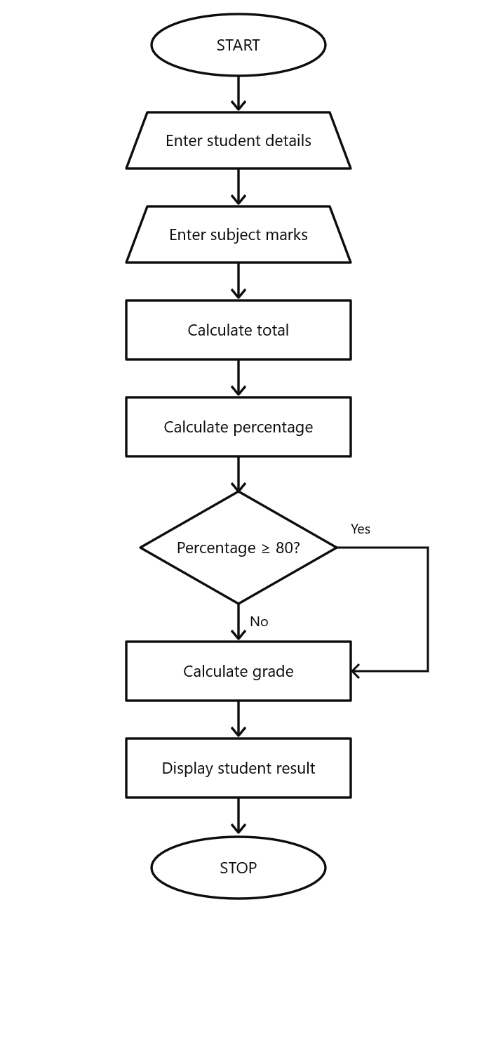
FlowChart

Slide 12
Code
#include <stdio,h>
char name[30];
struct Student
{
int roll;
int marks[5];
}
int main()
{
struct Student s;
int i, total = 0;
float percentage;
char grade; printf("Enter Roll Number: ");
scanf("%d", &s.roll);
printf("Enter Student Name: ");
scanf(" %29[^\n]", s.name);
for(i = 0; i < 5; i++)
{
printf("Enter marks of subject %d: ", i+1);
scanf("%d", &s.marks[i]);
total = total + s.marks[i];
}
percentage = total / 5.0;
if(percentage >= 80)
grade = 'A';
else if(percentage >= 60)
grade = 'B';
else if(percentage >= 40)
grade = 'C';
else
grade = 'F’;
printf("\n--- Student Result ---");
printf("\nRoll Number: %d", s.roll);
printf("\nName: %s", s.name);
printf("\nTotal Marks: %d", total);
printf("\nPercentage: %.2f%%", percentage);
printf("\nGrade: %c", grade);
return 0;
}
9

Slide 13
Sample output
Enter Roll Number: 101
Enter Student Name: Ram
Enter marks of subject 1: 80
Enter marks of subject 2: 75
Enter marks of subject 3: 85
Enter marks of subject 4: 70
Enter marks of subject 5: 90
--- Student Result ---
Roll Number: 101
Name: Ram
Total Marks: 400
Percentage: 80.00%
Grade: A
10

Slide 14
Advantages
Easy to use and understand.
Saves time in calculating marks.
Calculates percentage automatically.
Reduces manual calculation errors.
Displays student results clearly.
11

Slide 15
Limitations
It handles only one student at a time.
It does not save records permanently.
It has only five subjects.
It does not have a graphical interface.
12

Slide 16
Conclusion
By making this project, I learned how to use C programming to solve a simple real-life problem. This program helps calculate student marks, percentages and grades easily.
It also helped me understand important C concepts such as structures, arrays, loops and conditional statements. Overall, this project improved my basic programming and problem-solving skills.
Thank You
13

